Slide 1
Traffic Sign Recognition Deep Learning 046211
Students: Kfir Levi, Li-or Bar David
Semester: Spring 2021

Slide 2
Abstract
Implement in PyTorch a model from TensorFlow
Compare performance with known architectures
Test accuracy with and without data augmentation

Slide 3

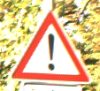

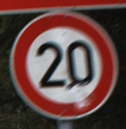
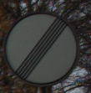
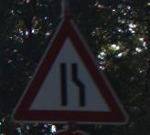
The GTSRB Dataset
Over 50,000 samples of 43 classes
Labeled 30x30 pre-processed images of traffic signs
Ground Truth: 12
Ground Truth: 18
Ground Truth: 9
Ground Truth: 0
Ground Truth: 32
Ground Truth: 24

Slide 4
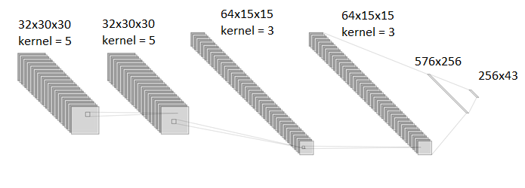
The Original network
4 convolutional layers
ReLU activation function, max pooling and dropout
2 Fully-Connected layers

Slide 5
The other models
CifarCNN
Transfer Learning with fine tuning:
ResNet-18
DenseNet

Slide 6
Results
 | Original | CifarCNN | ResNet-18 | DenseNet
Original Data | 96.097% | 96.785% | 96.825% | 98.060%
Augmentation | 96.793% | 97.356% | 98.480% | 98.393%
Noise | 59.691% | 49.042% | 83.753% | 79.881%

Slide 7
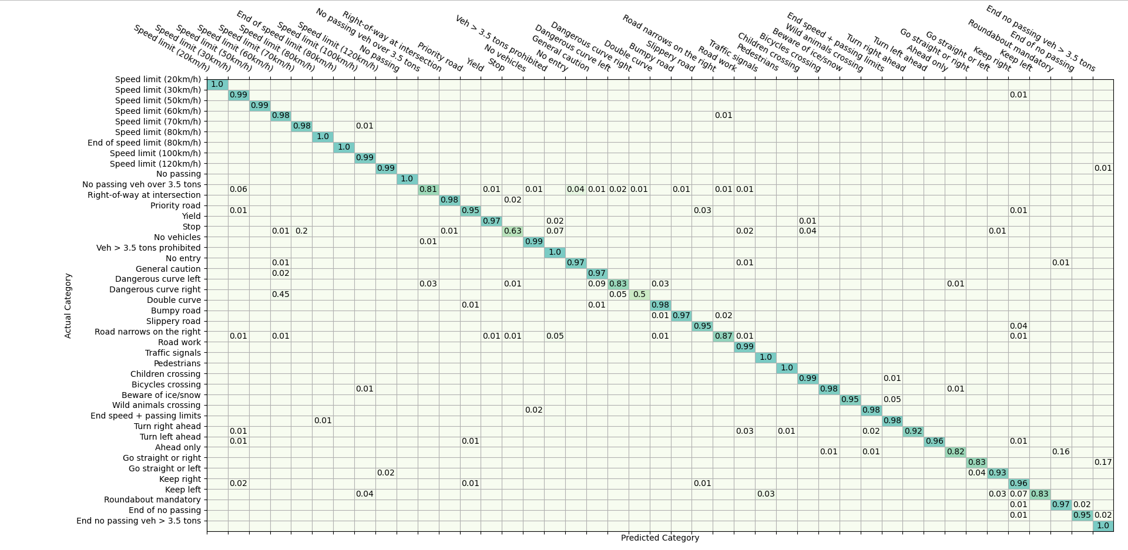



Slide 8
Thanks for watching!

